Slide 1
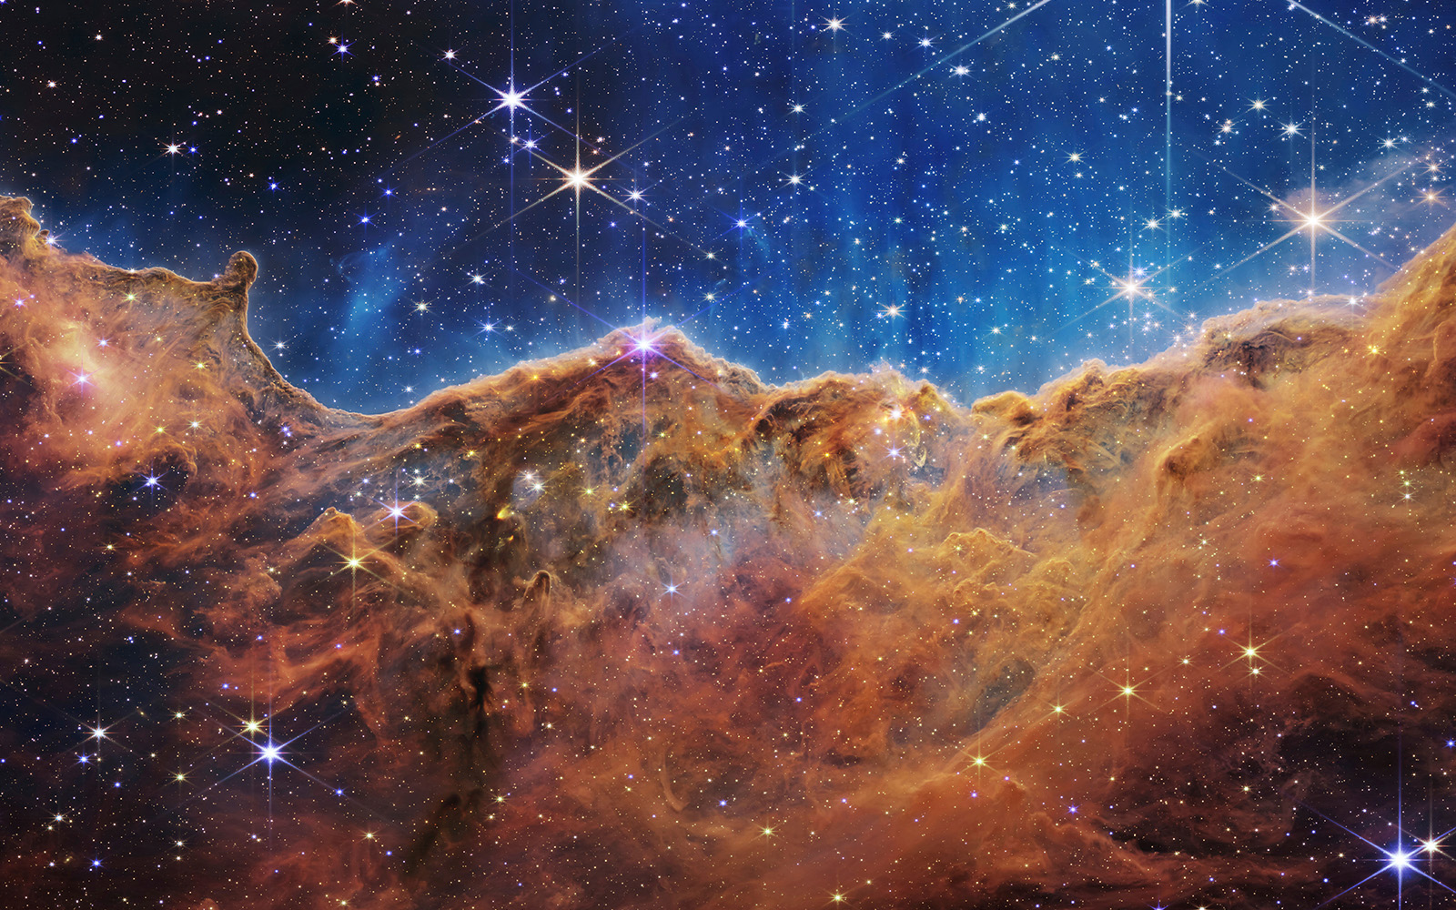
Stellar life cycle
Created by Aida and Negar
Power point : Negar

Slide 2
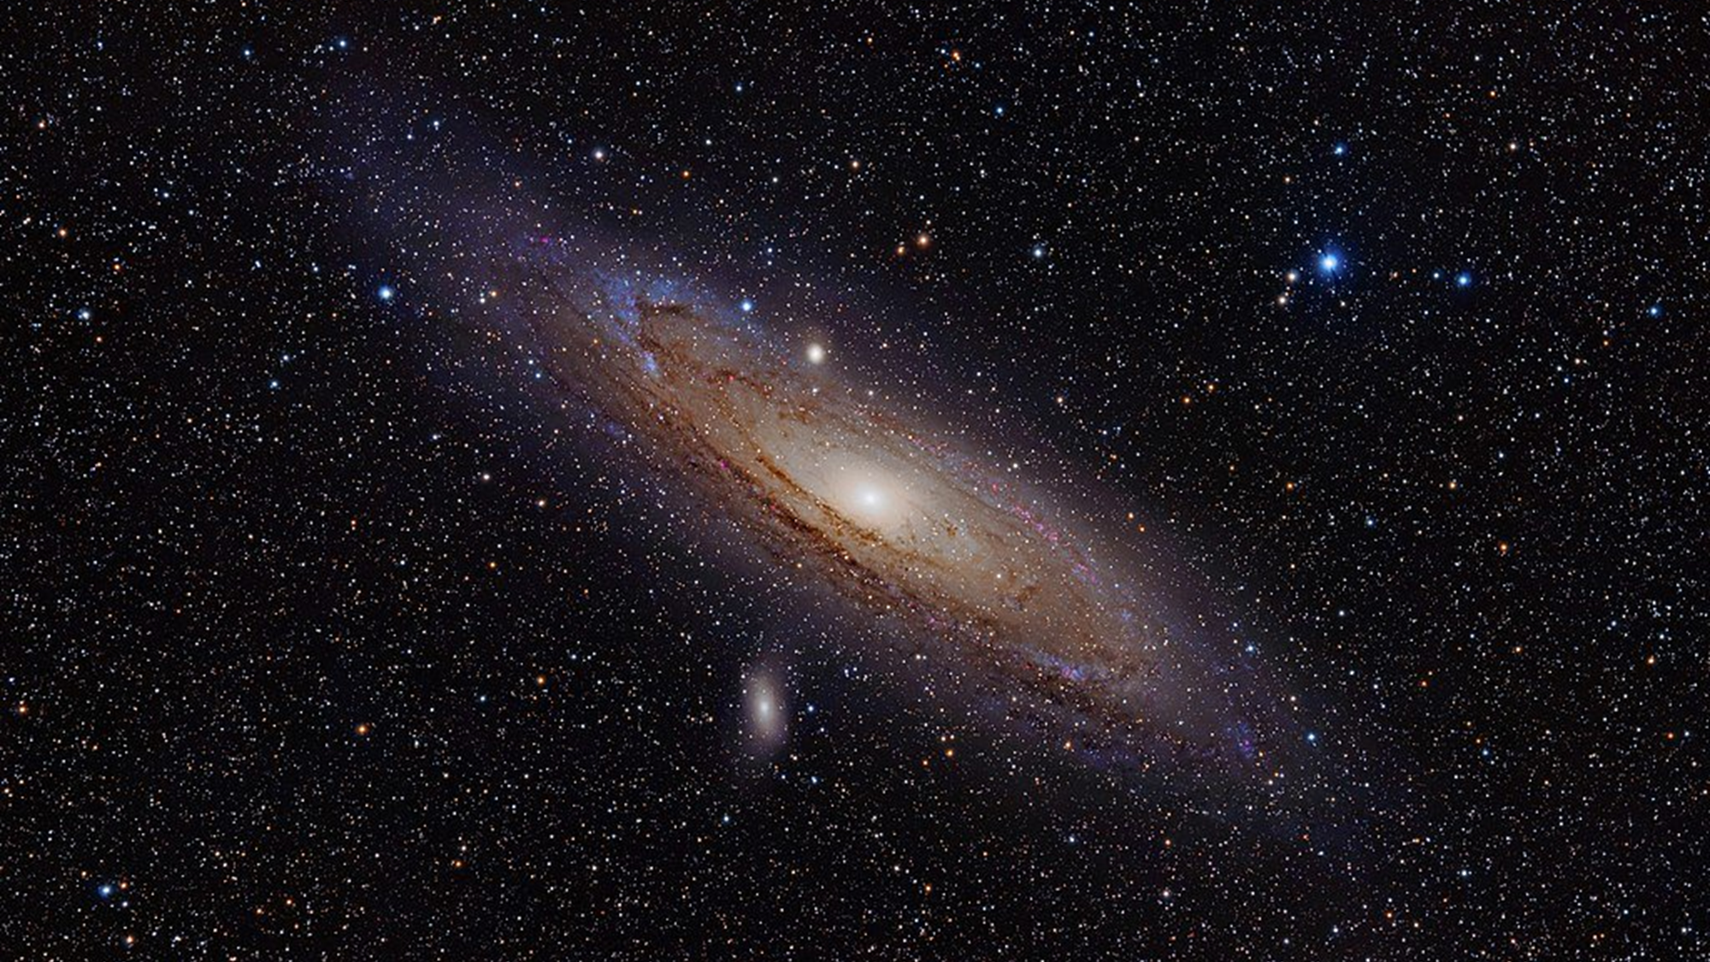
Have you ever paid attention to stars? And have you asked how stars are formed and how long do they live?

Slide 3
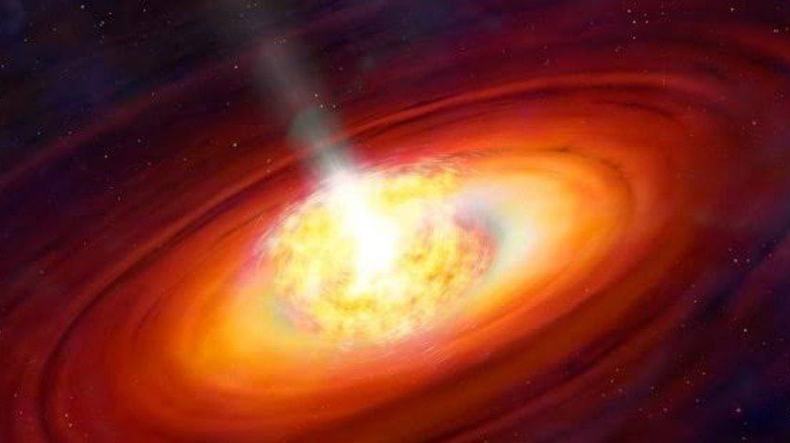
What are stars?
stars are large balls of hot gas.
They look small because they are a long way away. But in fact many are bigger and brighter than the sun.
The heat of the star is made in the center by nuclear fusion reactions
There are lots of different colors and sizes of star

Slide 4
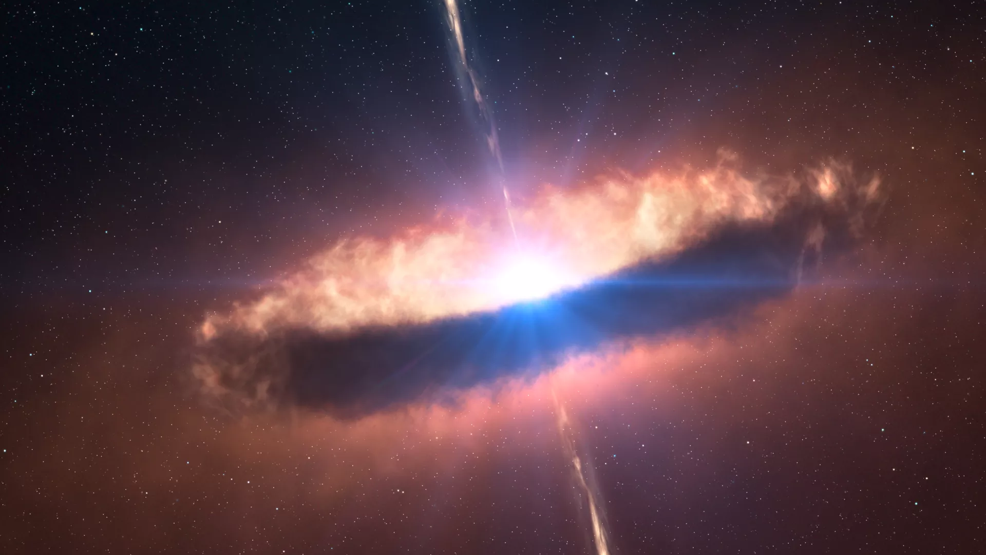
BIRTH

Slide 5
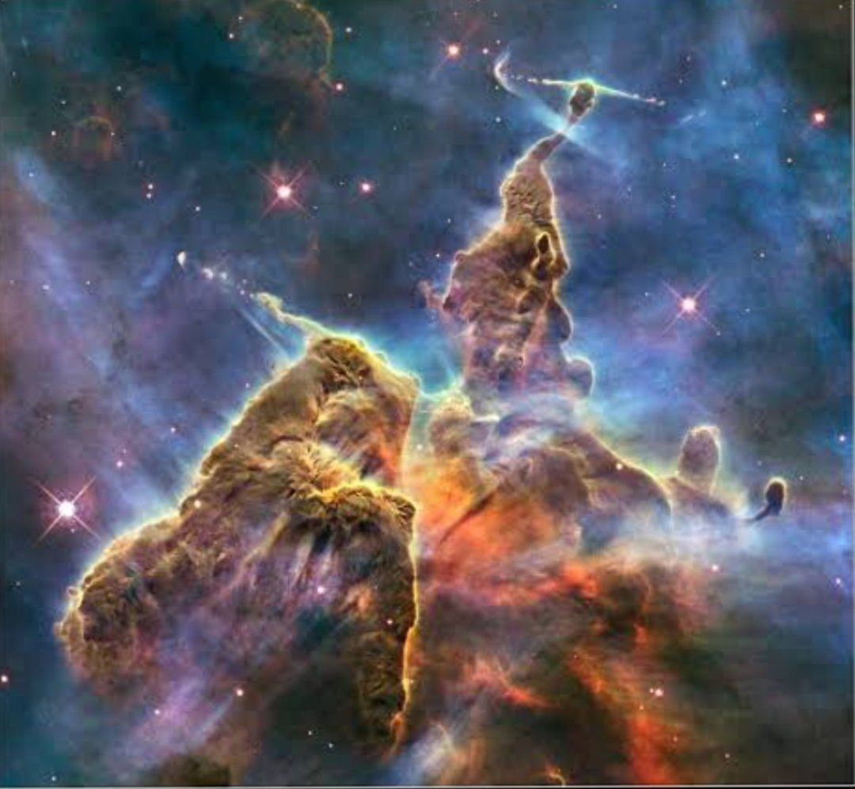
We live in a relatively quiet district of a galaxy 100,000 light-years across that contains around 200 billion stars arranged in a disk beset with spiral arms. Astronomers think that a star begins to form as a dense cloud of gas in the arms of spiral galaxies

Slide 6
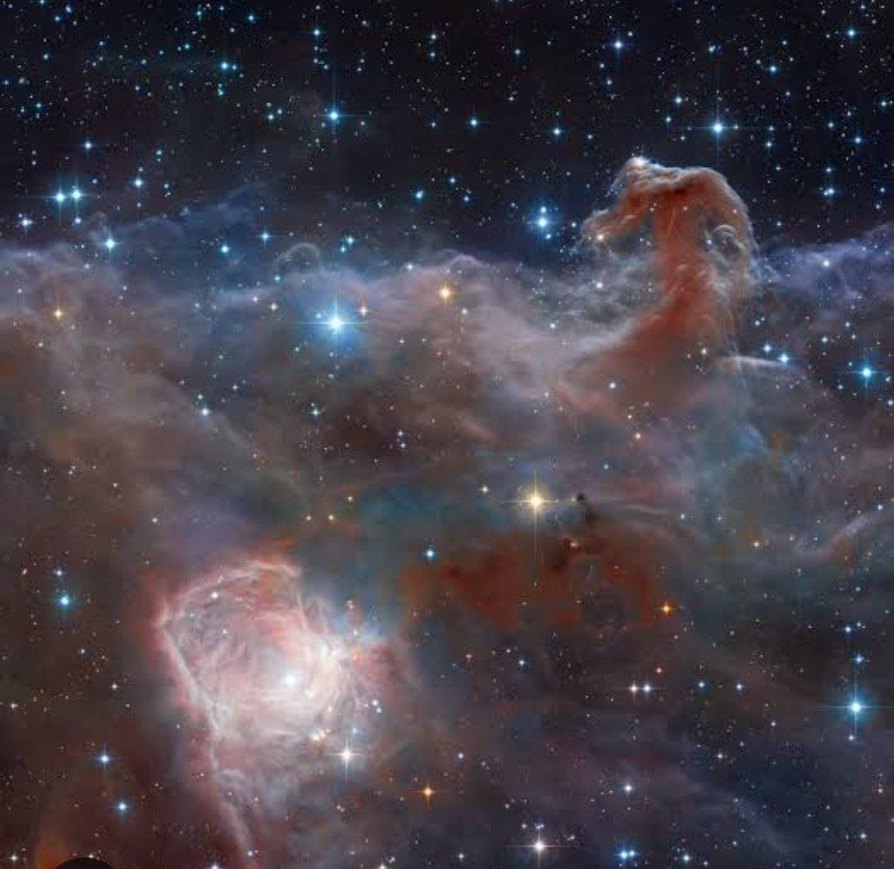
Individual hydrogen atoms fall with increasing speed and energy toward the center of the cloud under the force of the star's gravity. The increase in energy heats the gas. When this process has continued for some millions of years, the temperature reaches about 20 million degrees Fahrenheit.
At this temperature, the hydrogen within the star ignites and burns in a continuing series of nuclear reactions. The onset of these reactions marks the birth of a star.

Slide 7
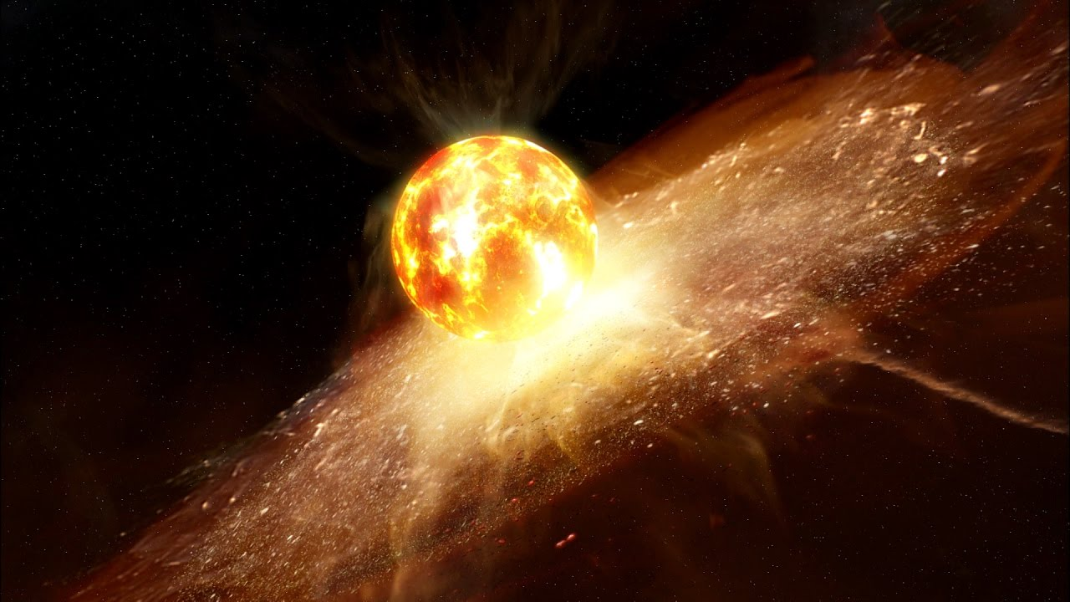
Death

Slide 8
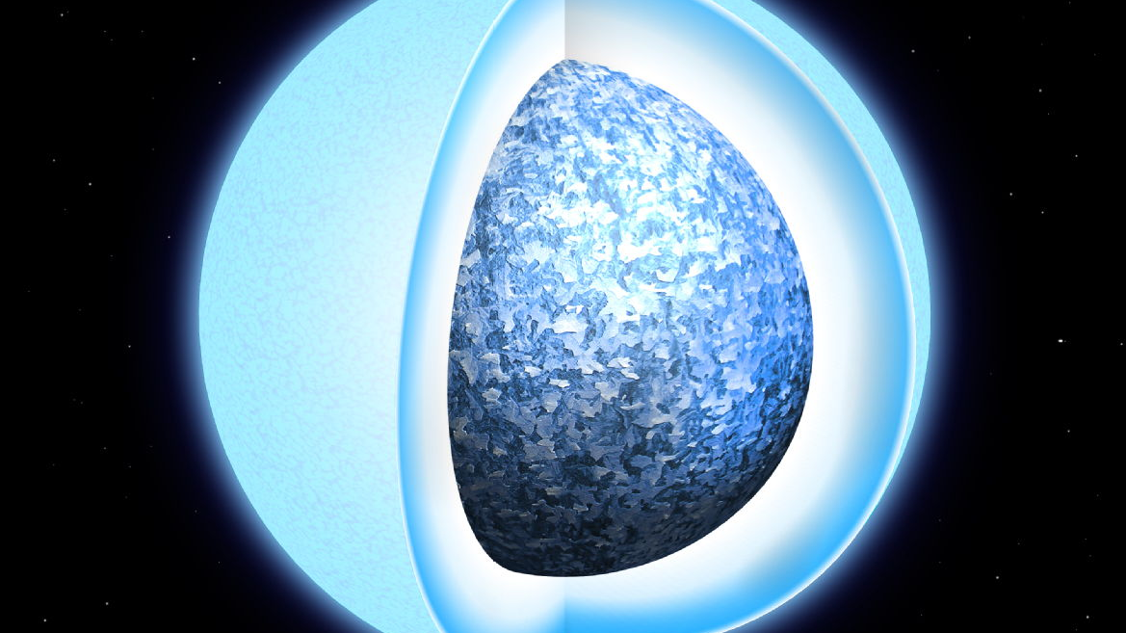
Step One: White Dwarfs
The Sun is destined to be transformed into the first of the three superdense bodies created when a star dies, a white dwarf. Billions of years from now, our star will begin to run out of the hydrogen that fuels the nuclear reactions in its core. When most of the hydrogen is gone, the core will get both denser and hotter. This extra heat will cause the Sun's outer layers to expand outward,

Slide 9
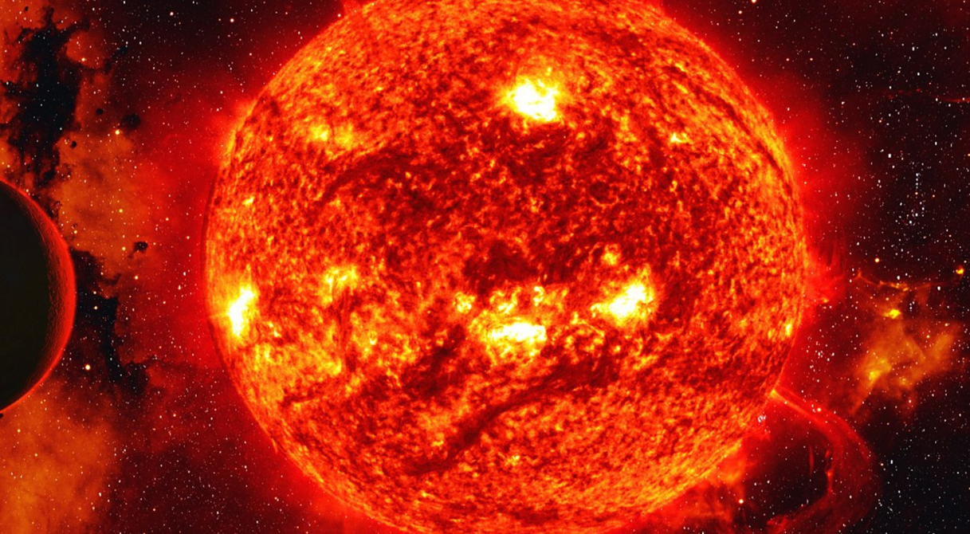
transforming it into an enormous star hundreds of times bigger than it is now; in fact, its surface will engulf the orbits of Mercury and Venus, destroying those planets, and the surface of Earth (which will then be the innermost planet in the solar system) will be scorched as if in a blast furnace. However, because the Sun's new surface will be stretched and more spread out than before, any given portion of it will be a bit cooler. So the star's color will change from a hot yellow to a cooler red. For this reason such expanded, cooler stars are called red giants.

Slide 10
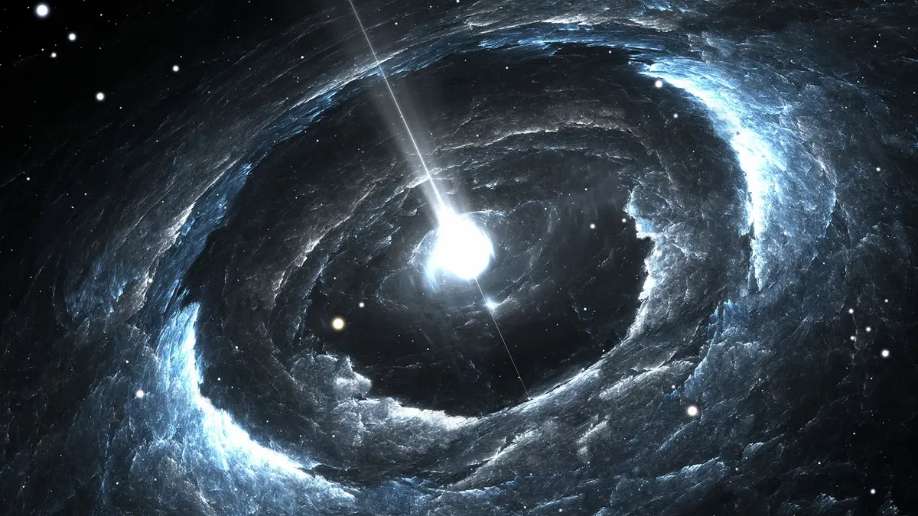
Step Two: Neutron Stars
A neutron star is the collapsed core of a massive supergiant star, which had a total mass of between 10 and 25 solar masses, possibly more if the star was especially metal-rich

Slide 11
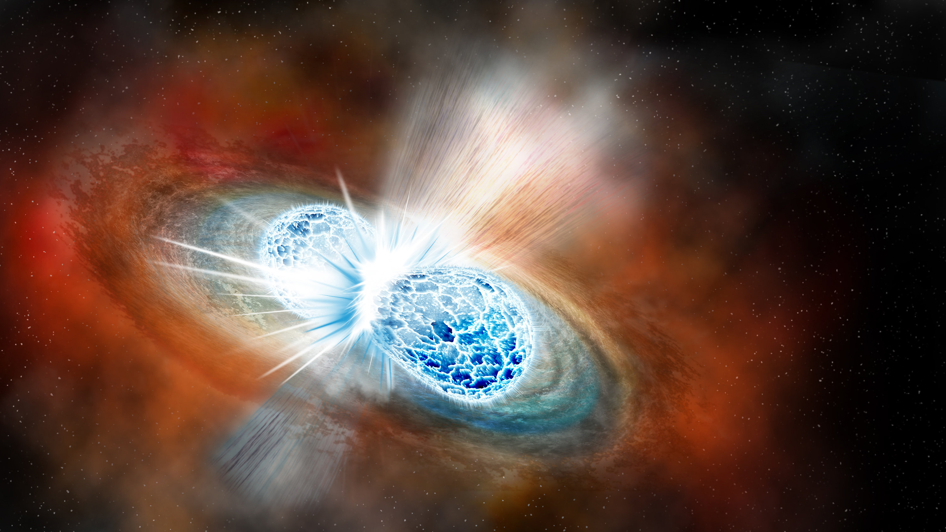
Instant Death on a Neutron Star
Neutron stars have enormous gravity, which would cause a living creature to be crushed out of existence in a fraction of a second

Slide 12
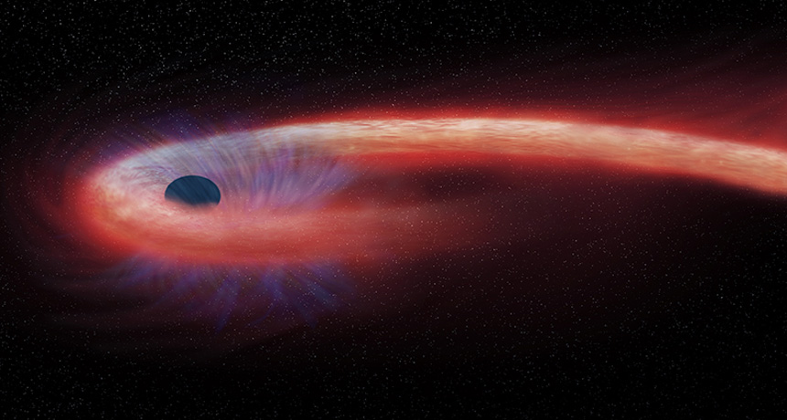
Step Three: Stellar Black Holes
A stellar black hole forms from the collapse of a star having more than eight times the mass of the Sun. So powerful is the force of the inrushing matter that it bypasses both the white dwarf and neutron star stages and compresses that matter into an even denser state. In fact, the matter keeps on falling down the star's gravity well in a sort of neverending death spiral. This is because the gravity well of a black hole is like a bottomless pit, from which nothing can escape.

Slide 13
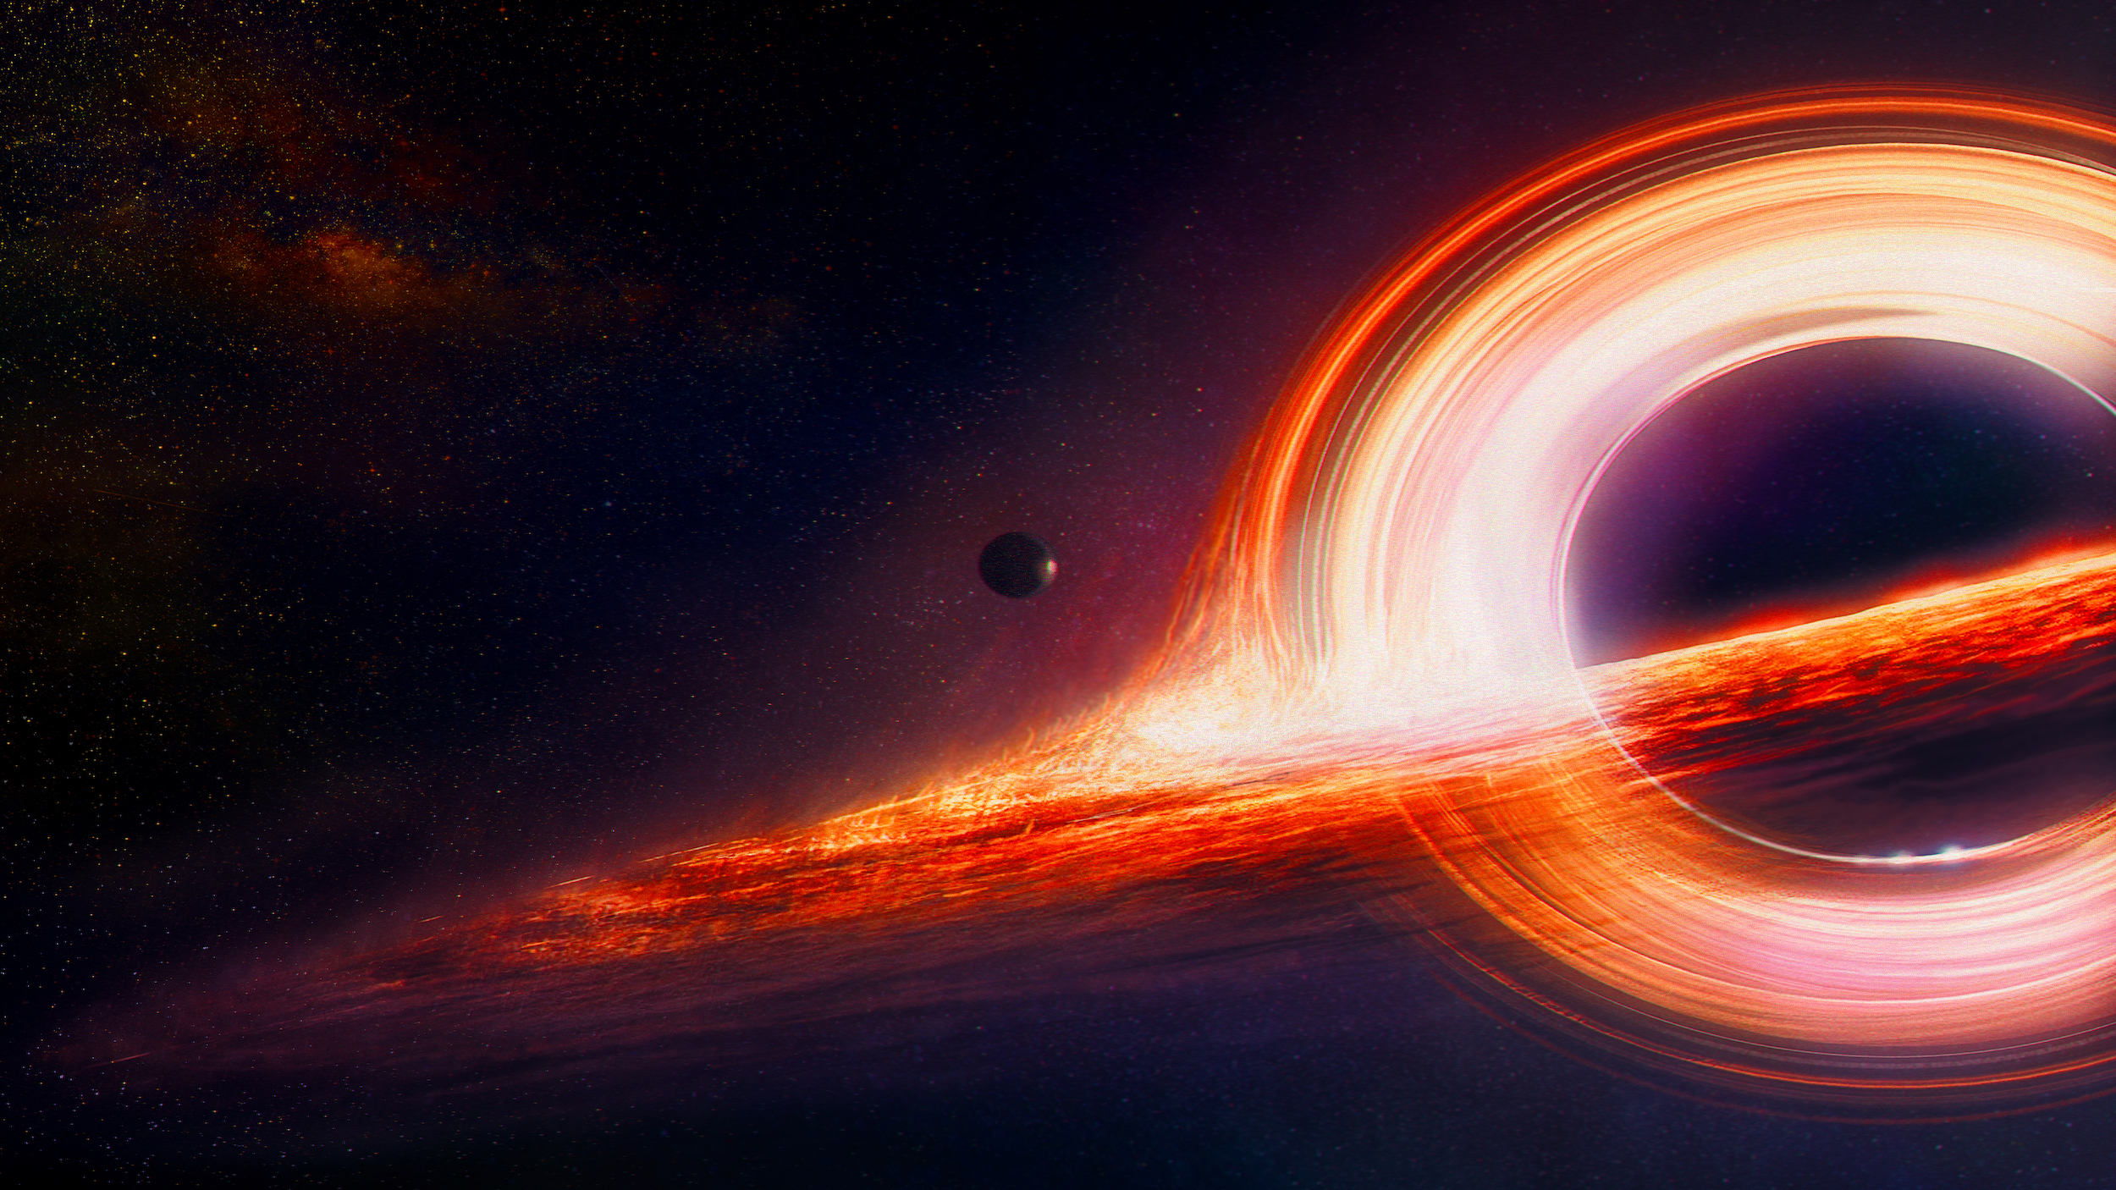
Not surprisingly, this densest of superdense objects jams an extremely large amount of material into a very small volume of space. A stellar black hole is surprisingly small, therefore. One formed during the death of a star having eight solar masses would probably be only about the size of a small house. It is important to remember that most of the former star's original matter is still inside the black hole.

Slide 14
Thanks for your attention

